Slide 1

Project On Face Recognition System to Mark Attendance of Students and generate an non temporary certificate.
(A.B.V.G.I.E.T Students)
Sahil Kumar
Ankit Chaudhary
Diksha Anand
Jyoti Devi

Slide 2
INTRODUCTION
The main aim of Face Recognition System project is develop a security lock system based on face scanning. In this project we are using MATLAB.
The project is designed as secure
storage of data of the students (attendance),
documents, and other valuable items.
This utilize face recognition technology
to allow access to only whose faces you
choose.

Slide 3
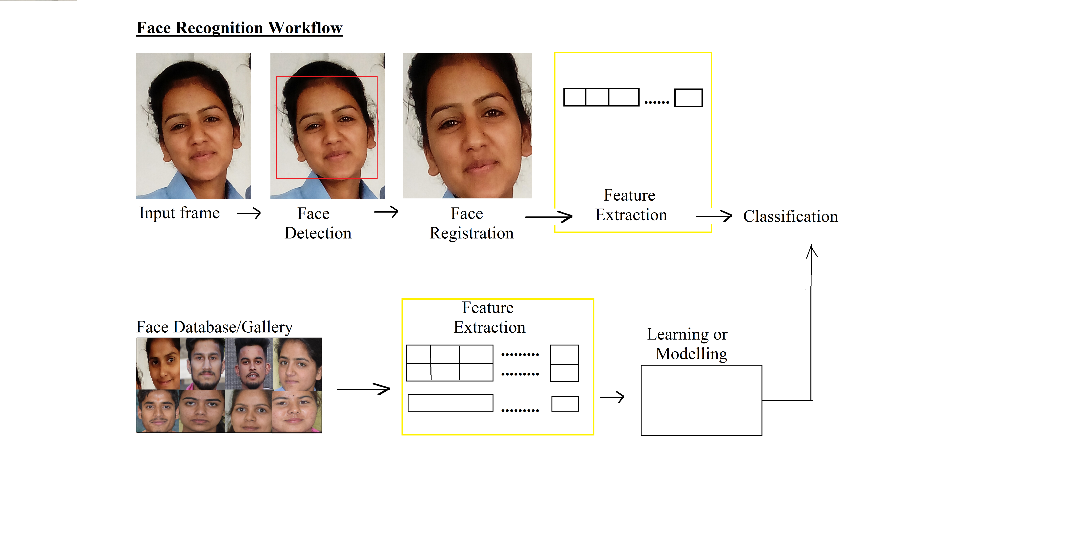
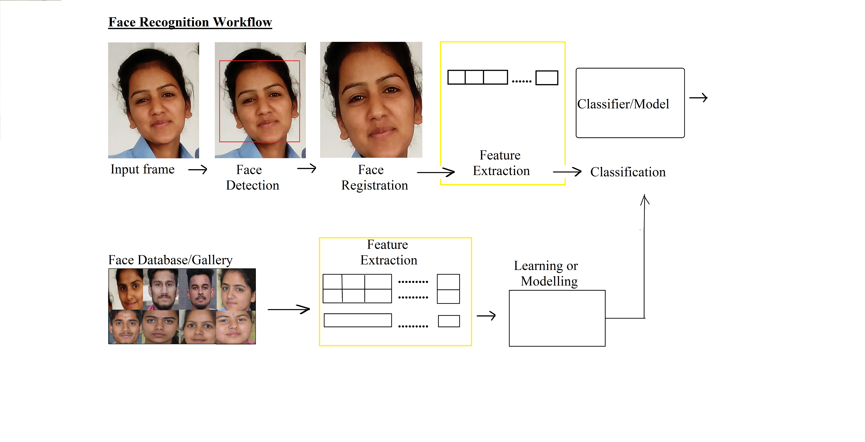
BLOCK DIAGRAM

Slide 5
PLUS POINTS
A number of faces can be recognized and store at once .

Slide 6
ADVANTGES:
Proxy attendance is eliminated
Less mistakes
Unique & highly Secure
Easier ,cheaper and faster to set up
High accuracy
No physical contact
Get rid of pen-paper system

Slide 7
DISADVANTAGES:
Change in Appearance and camera angle
Top quality cameras are required

Slide 8
APPLICATIONS
Universities ,school and Collages
Criminal Identification
Healthcare

Slide 9
CONCLUSION:
In this system we have implemented an attendance system for a lecture, section or laboratory by which lecturer or teaching assistant can record students attendance.
It saves time and effort ,especially if it is a lecture with huge number of students.
Automated attendance system has been envisioned for the purpose of reducing the drawbacks in the traditional system .
This attendance system demonstrates the use of image processing techniques in classrooms .this system cannot only nearly help in the attendance system , but also improve the goodwill of an institution.

Slide 10
FUTURE SCOPE:
The system we have developed has successfully , able to accomplish the task of marking the attendance in the classroom automatically and output is obtained in an excel sheet as desired in real time . However, in order to develop a dedicated system which can be implemented in an educational institution , a very efficient algorithm which is insensitive to the lighting conditions of the classroom has to be developed . Also a camera of the optimum resolution has to be utilized in the system. Another important aspect where we can work towards in creating an online database of the attendance and automatic updating of the attendance into it keeping in mind the growing popularity of internet of things. This can be done by creating a standalone module which can be installed in the classroom having access to internet , preferably a wireless system .

